Slide 1
Chiesi Group – Sustainability & Non-Financial Reporting

Slide 2
AGENDA
Sustainability – Finance Revolution
Sustainability in Chiesi Group
Non-Financial Reporting – Framework
Chiesi Group: Evolution of Non-Financial Reporting
Chiesi Group: Non-Financial Data Collection

Slide 3

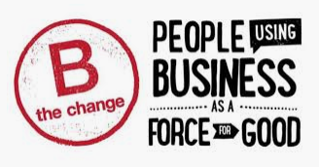

Slide 4

A real revolution: Inclusion of Sustainability issues in the objective of Finance
Climate change is leading to a profound risk reanalysis and, we expect, a significant reallocation of capital (BlackRock)

Slide 5
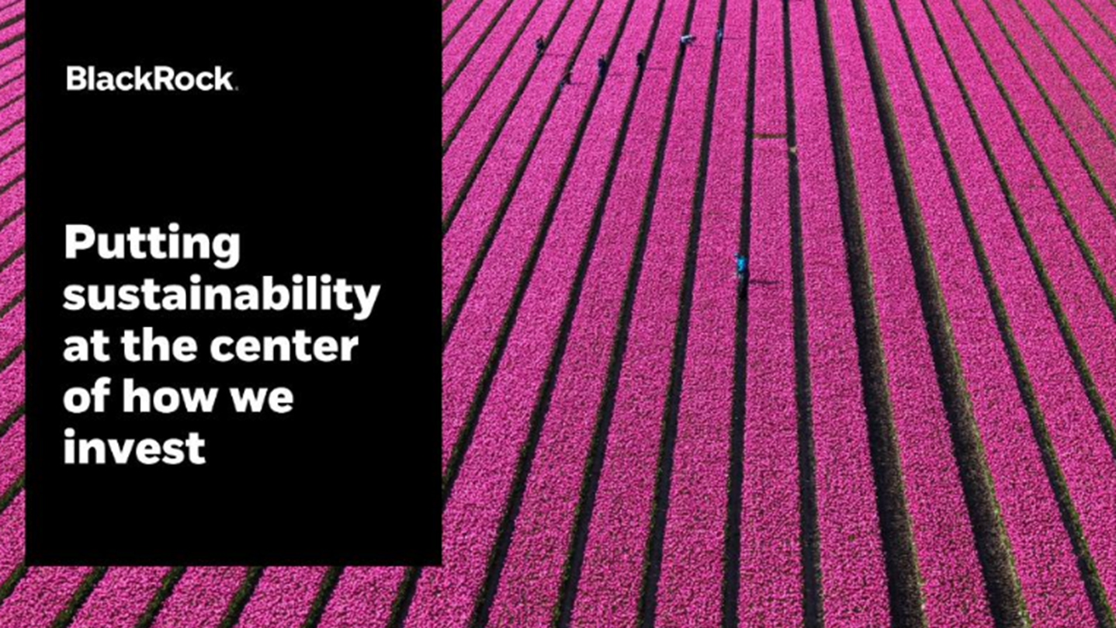
https://www.youtube.com/watch?v=C1jEDKGDoSo

Slide 6
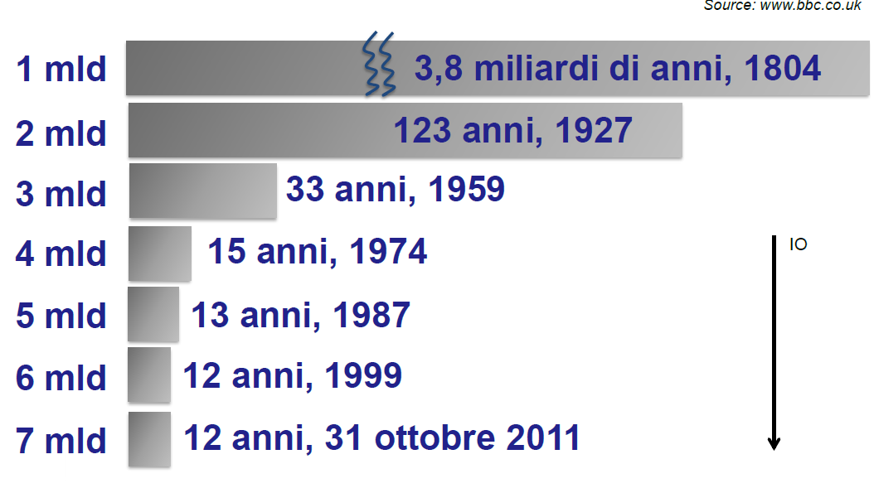

Slide 7
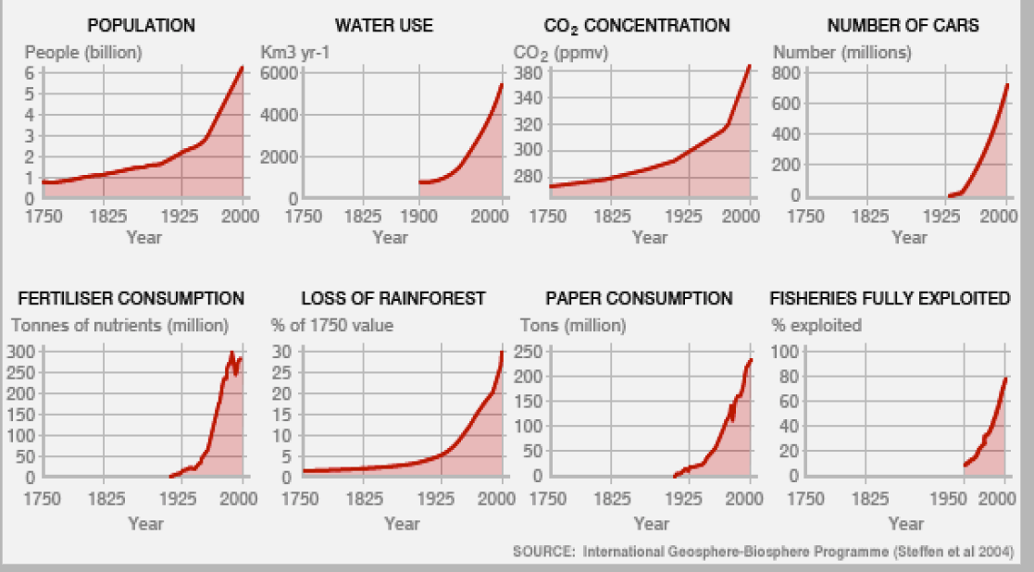

Slide 8
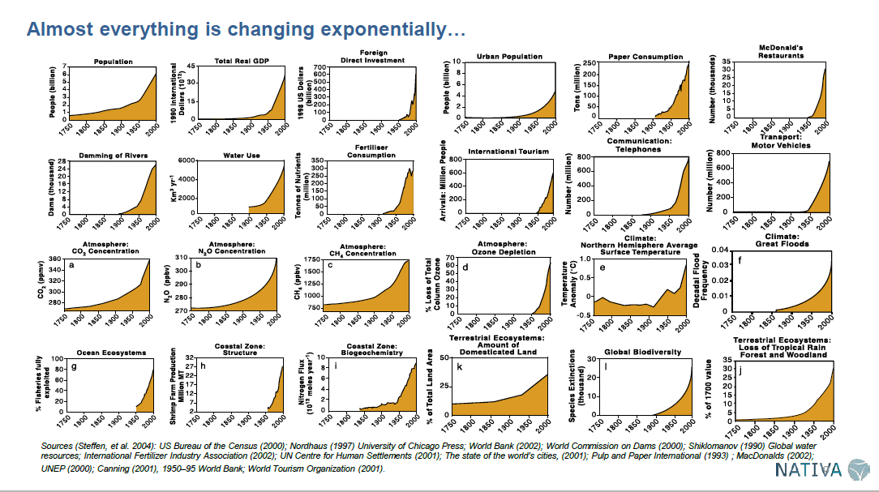

Slide 9
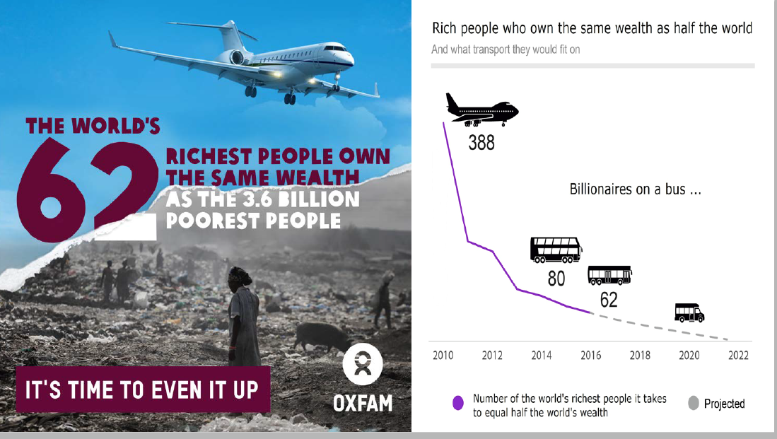

Slide 10
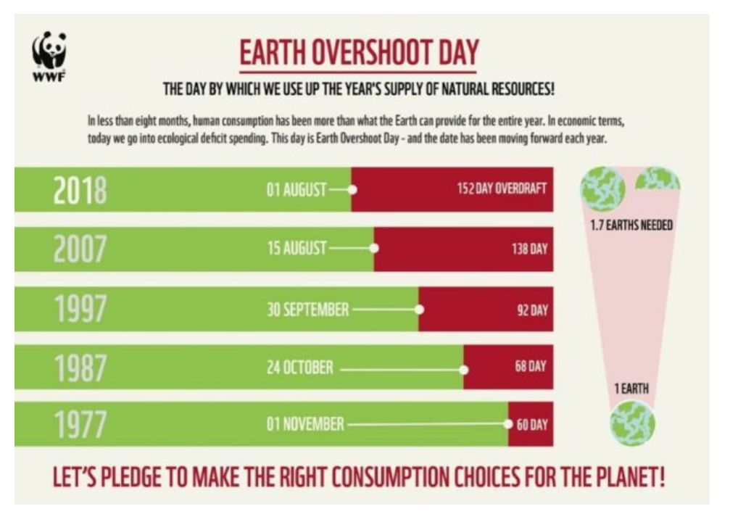

Slide 11
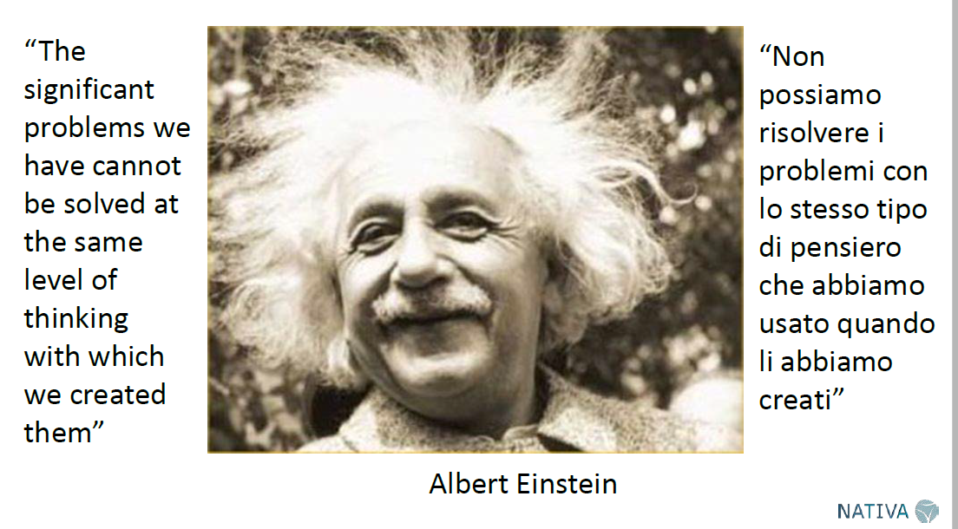

Slide 12
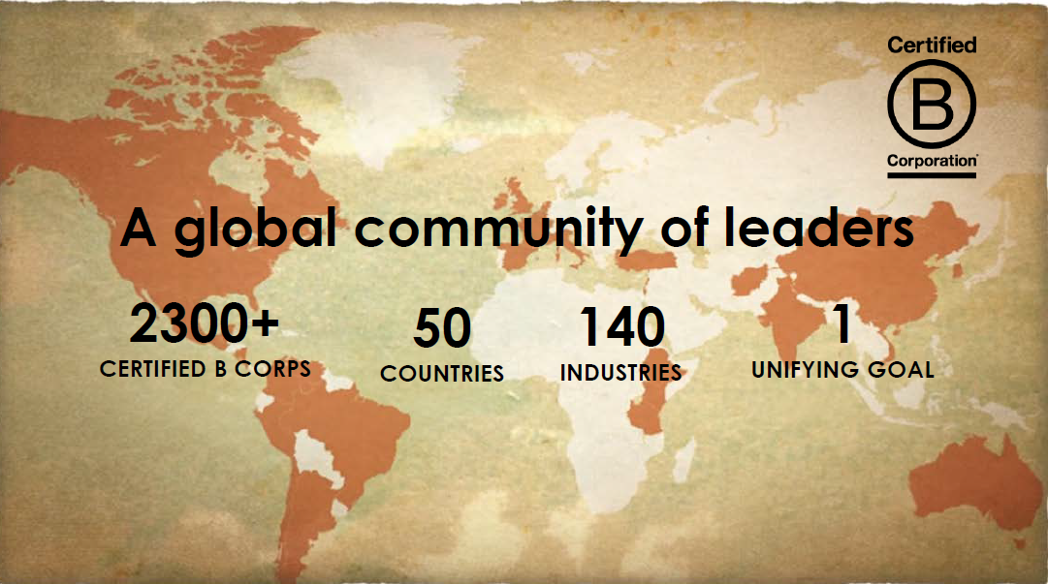

Slide 13
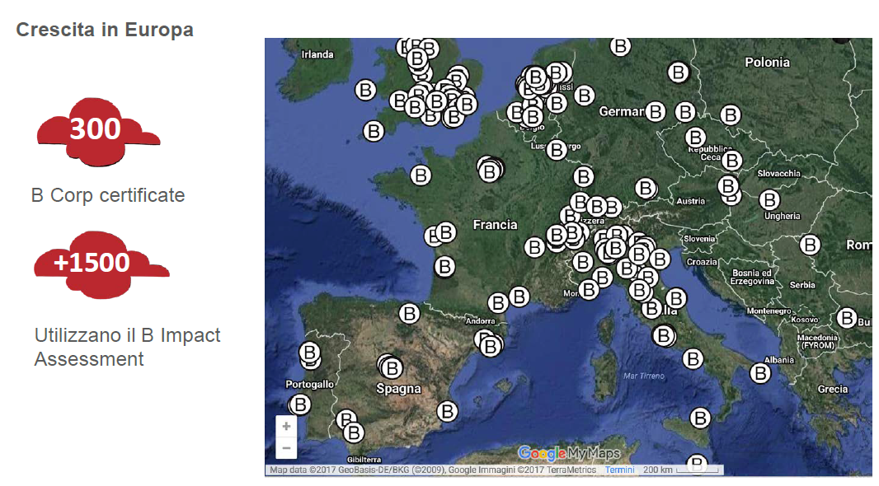

Slide 14
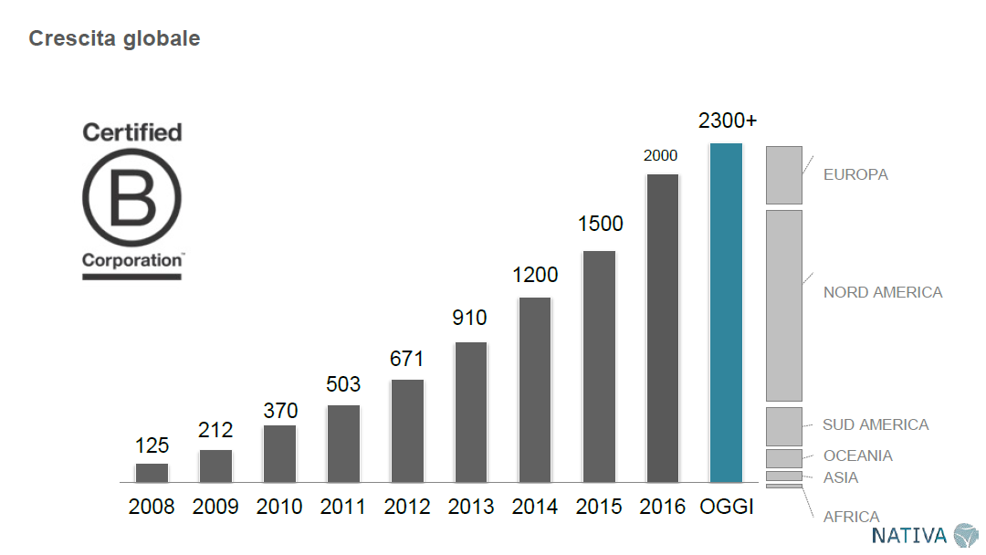

Slide 15
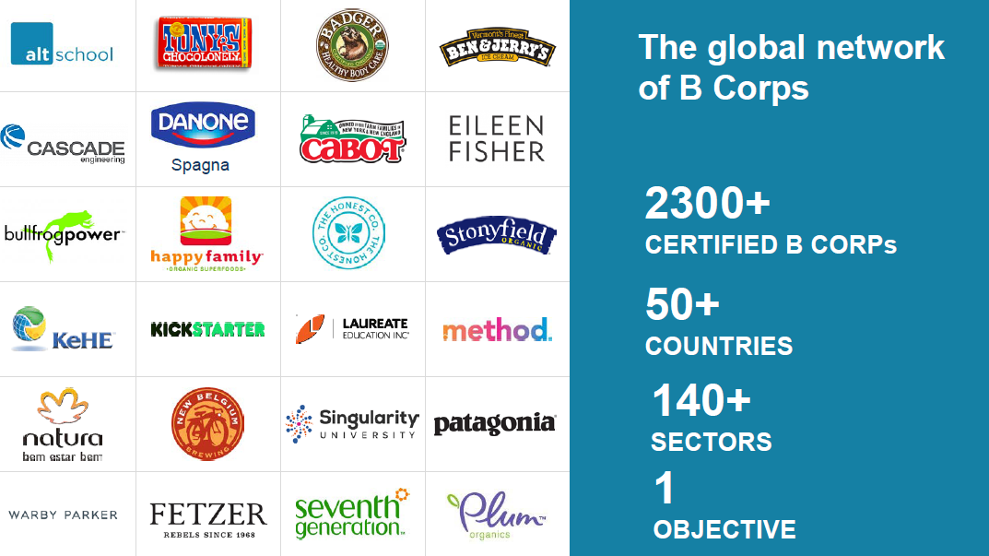

Slide 16
AGENDA
Sustainability – Finance Revolution
Sustainability in Chiesi Group
Non-Financial Reporting – Framework
Chiesi Group: Evolution of Non-Financial Reporting
Chiesi Group: Non-Financial Data Collection

Slide 17
SUSTAINABILITY IN CHIESI GROUP
B CORP ASSESMENT
CERTIFIED
B CORPORATION
CHIESI FARMACEUTICI & SPAIN
February
2018
Start
2019
2017
2018
SUSTAINABILITY
REPORT
BENEFIT CORPORATION
…..SINCE 2017
Sustainability Process 2019 – Corporate Finance CGI - 12/11/2019

Slide 18

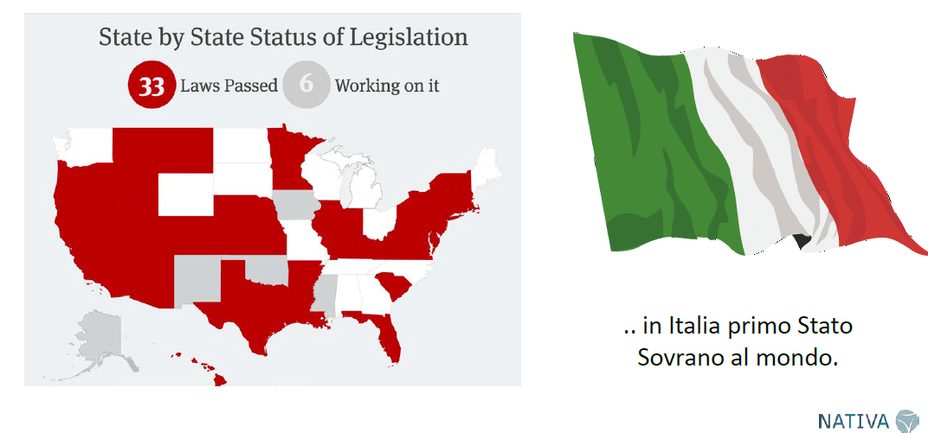
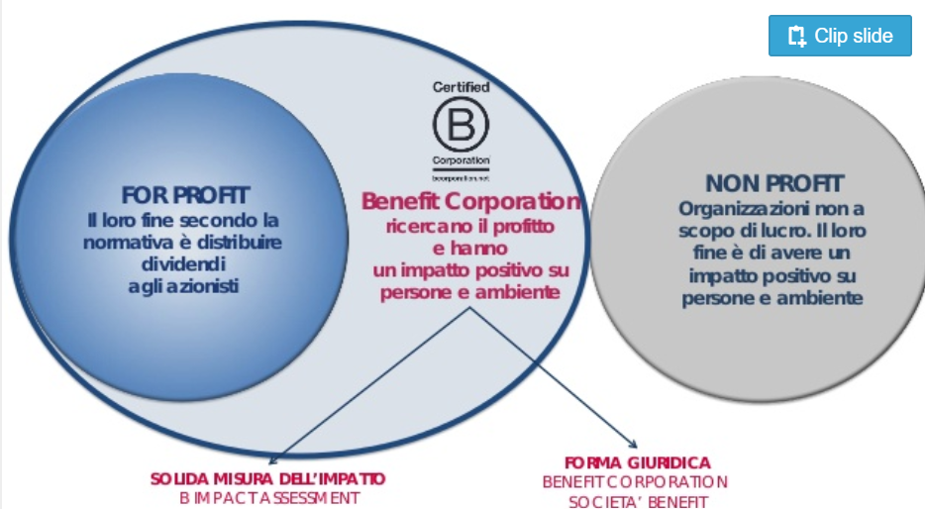
SUSTAINABILITY IN CHIESI GROUP: BENEFIT CORPORATION
NEW LEGAL STATUS
BENEFIT CORPORATION
A new innovative legal status under the Italian (Law no. 208/2015) and US law (Delaware)
Legal requirement
Chiesi is the first double purpose company in the pharma sector
This legal form allows companies to pursue a double purpose:
  to create value for shareholders
  to explicitly pursue a general public benefit, that is a material positive impact on society and the environment, assessed against a third-party standard
Sustainability Process 2019 – Corporate Finance CGI - 12/11/2019

Slide 19
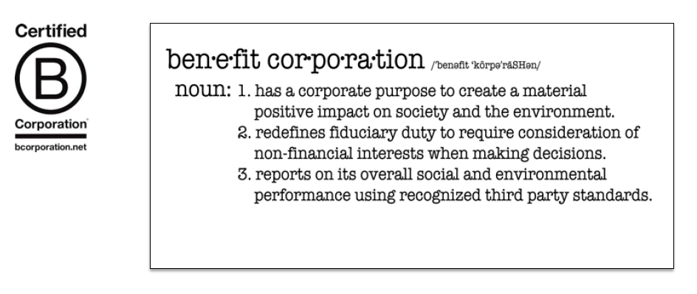
SUSTAINABILITY IN CHIESI GROUP: BENEFIT CORPORATION

Slide 20
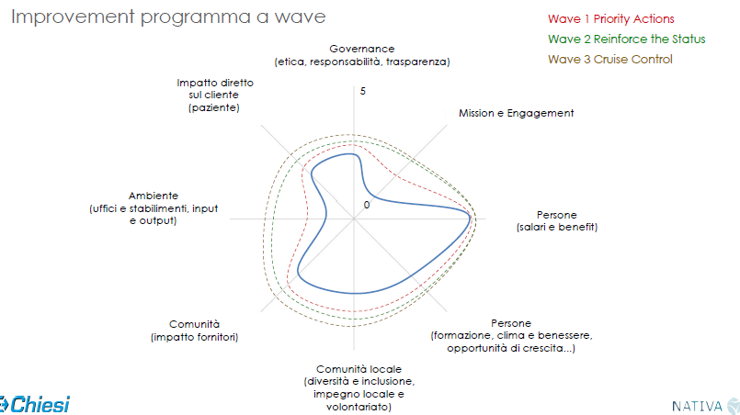

SUSTAINABILITY IN CHIESI GROUP: CERTIFIED B CORPORATION
Certified B Corporation
Scope
B LAB
(the certifier)
Society’s most challenging problems cannot be solved by government and non-profits alone. The B Corp community works toward reduced inequality, lower levels of poverty, a healthier environment, stronger communities, and the creation of more high quality jobs with dignity and purpose. By harnessing the power of business, B Corps use profits and growth as a means to a greater end: positive impact for their employees, communities, and the environment
An official recognition of the commitment to improve the quality of human life in a responsible manner towards society and environment
Non-profit body that serves a global movement of people using business as a force for good
Deadlines
BIA – B Impact Assessment
EVERY THREE YEARS for B Corporation Certification
EVERY YEAR for Impact Report (legal Request)
Is the most widely-used assessment for measuring the impact of a company on its workers, community, environment and customers: a global standard, as well as a benchmark tool with over 70,000 companies in the world;
Chiesi is the largest pharmaceutical company to be a Certified B Corporation in Europe
SCORE > 80
…IMPROVEMENT REQUIRED EVERY YEAR
Sustainability Process 2019 – Corporate Finance CGI - 12/11/2019

Slide 21
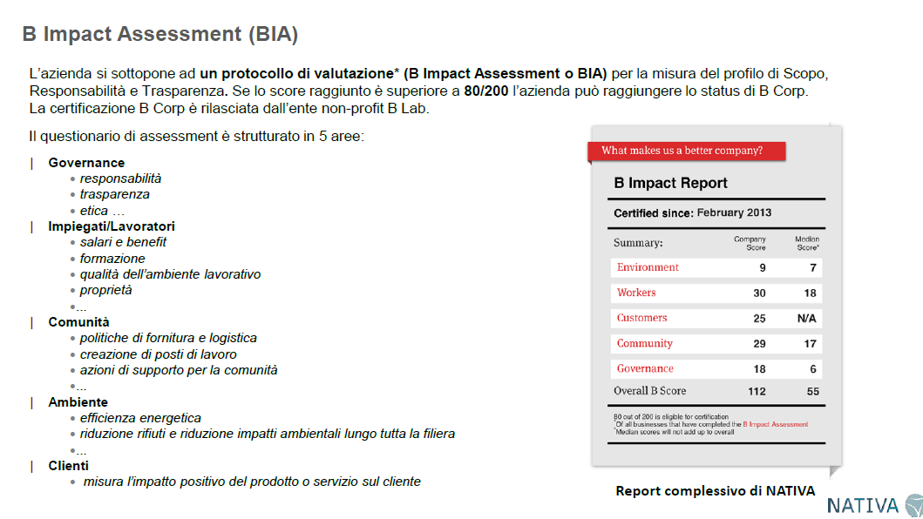

Slide 22
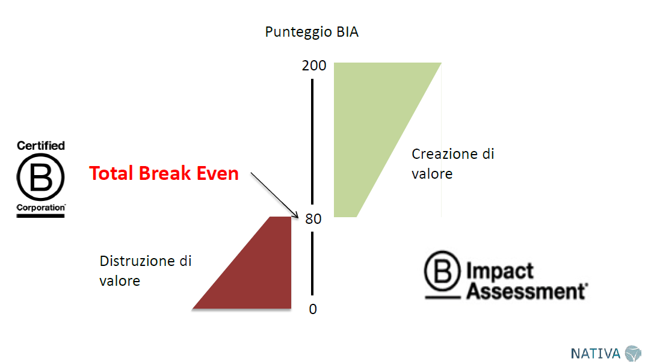

Slide 23
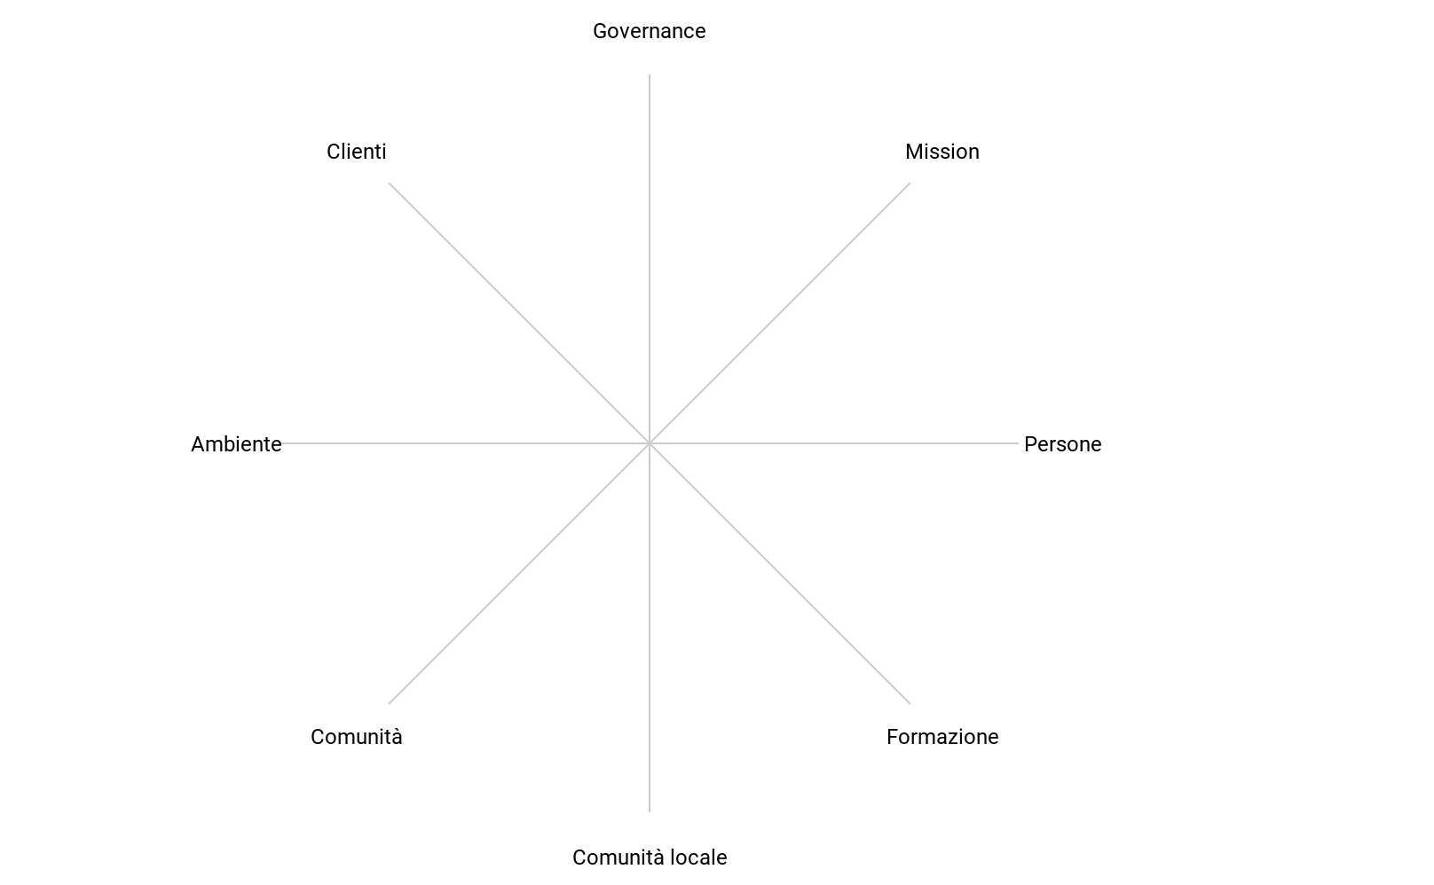

Chiesi HQ Impact Profile 2017 vs 2019 vs Group Target Profile
Governance
(accountability,ethics and transparency)
Patients
Mission & Engagement
2019
Environment
(facilities impact, input and output)
People
(compensations & benefits)
0
2017
Community: suppliers
(company’s suppliers relation, diversity, involvement and impact)
People
(trainings, work environment, flexibility, health & safety)
Community: local involvement
(diversity & Inclusion, community service and charitable giving)

Slide 24
AGENDA
Sustainability – Finance Revolution
Sustainability in Chiesi Group
Non-Financial Reporting – Framework
Chiesi Group: Evolution of Non-Financial Reporting
Chiesi Group: Non-Financial Data Collection

Slide 25


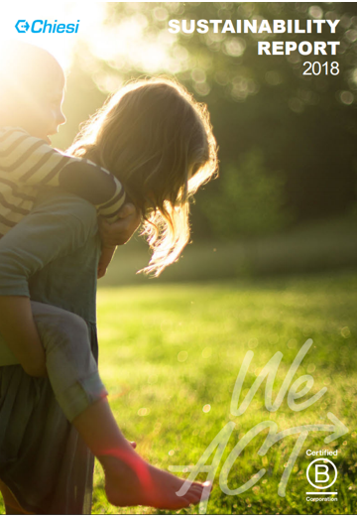


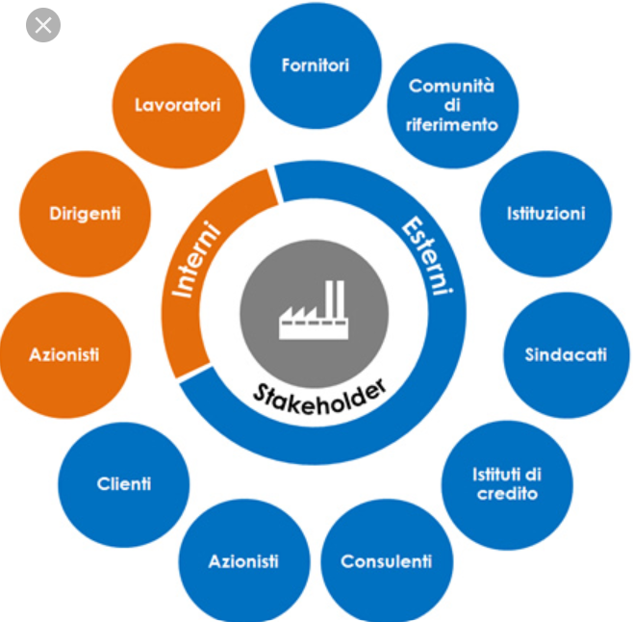

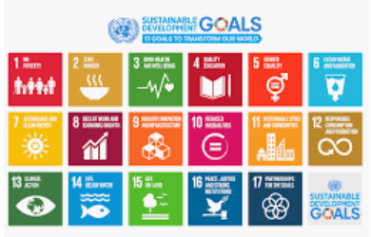
NON-FINANCIAL REPORTING FRAMEWORK (some example)
LEED & OTHER CERTIFICATION
U.S. Green Building Council (USGBC)
SUSTAINABILITY
&
NON-FINANCIAL REPORTING

Slide 26
AGENDA
Sustainability – Finance Revolution
Sustainability in Chiesi Group
Non-Financial Reporting – Framework
Chiesi Group: Evolution of Non-Financial Reporting
Chiesi Group: Non-Financial Data Collection

Slide 27
CHIESI GROUP: EVOLUTION OF NON-FINANCIAL REPORTING
Possible Next Step
2019
Integrated Reporting (Financial & Non-Financial Reportong)
2018
Integrated Reporting (only for Non-Financial Framework)
2017
Sustainability Report
B Impact Assestment
Sustainability Report
Impact Report
Better Building

Slide 28



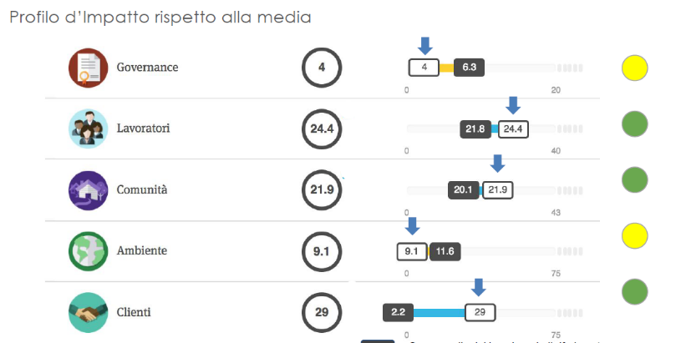

CHIESI GROUP: EVOLUTION OF NON-FINANCIAL REPORTING (2017-2018)
FRAMEWORK
GRI
B Impact Assestment
BETTER BUILDING
REPORTING
IMPACT REPORT
Legal Requirement for Benefit Corporation
LEED & OTHER CERTIFICATION
U.S. Green Building Council (USGBC)
SUSTAINABILITY REPORT
SUSTAINABILITY STRATEGIC PLAN

Slide 29
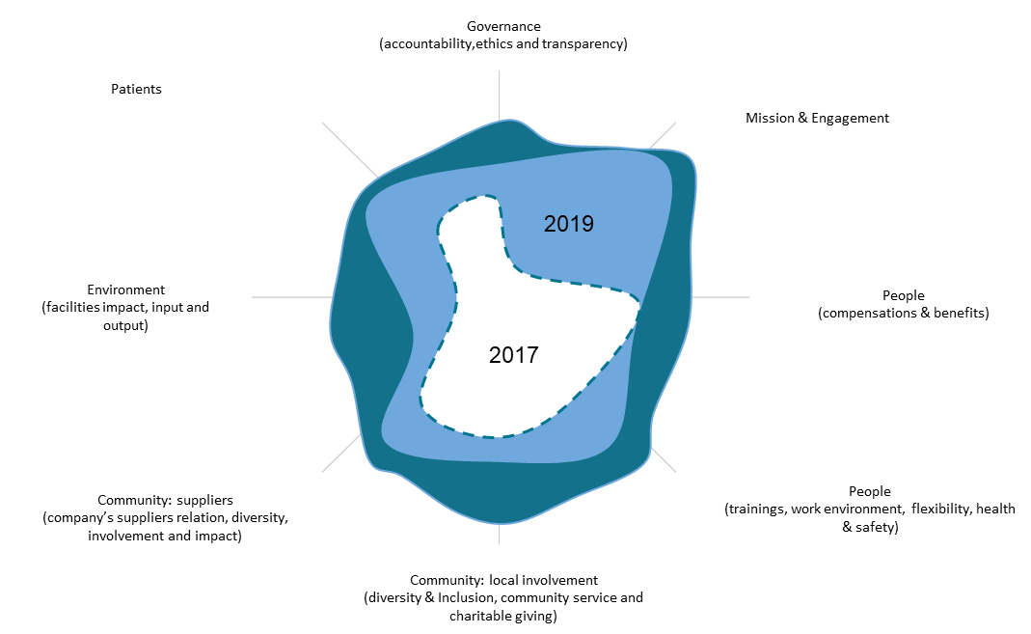

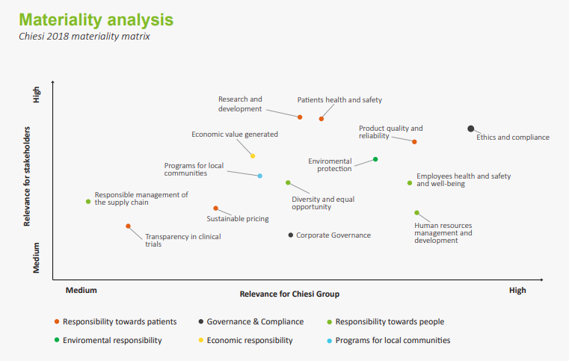


CHIESI GROUP: EVOLUTION OF NON-FINANCIAL REPORTING (2019)
OBJECTIVE 2019: «INTEGRATED» REPORT 2019 (only Non-financial Framework)
Index Draft
Products
Processes/Environmental impact
Global Value chain
Corporate Citizenship
IMPACT PROFILE
IMPACT REPORT
SDGs
GRI STANDARDS

Slide 30
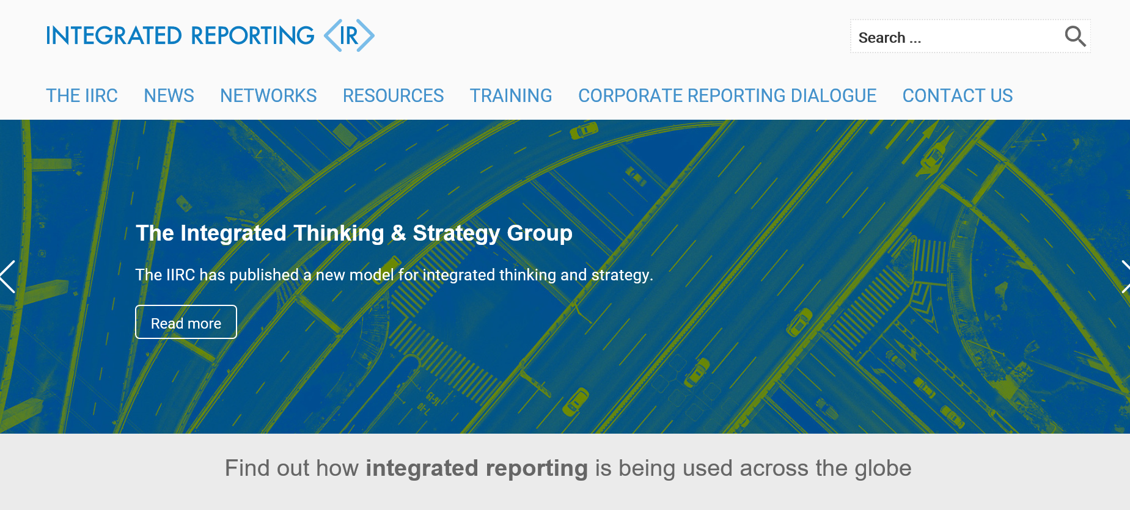
CHIESI GROUP: EVOLUTION OF NON-FINANCIAL REPORTING
NEXT REPORTING CHALLENG
integratedreporting.org

